Slide 1
World Happiness Index Prediction
Supervised ML - Regression

Slide 2
Data Acquisition
–2015, 2016, 2017, 2018, 2019
Inconsistency in column names
Mismatch in order of columns
Missing columns

Slide 3
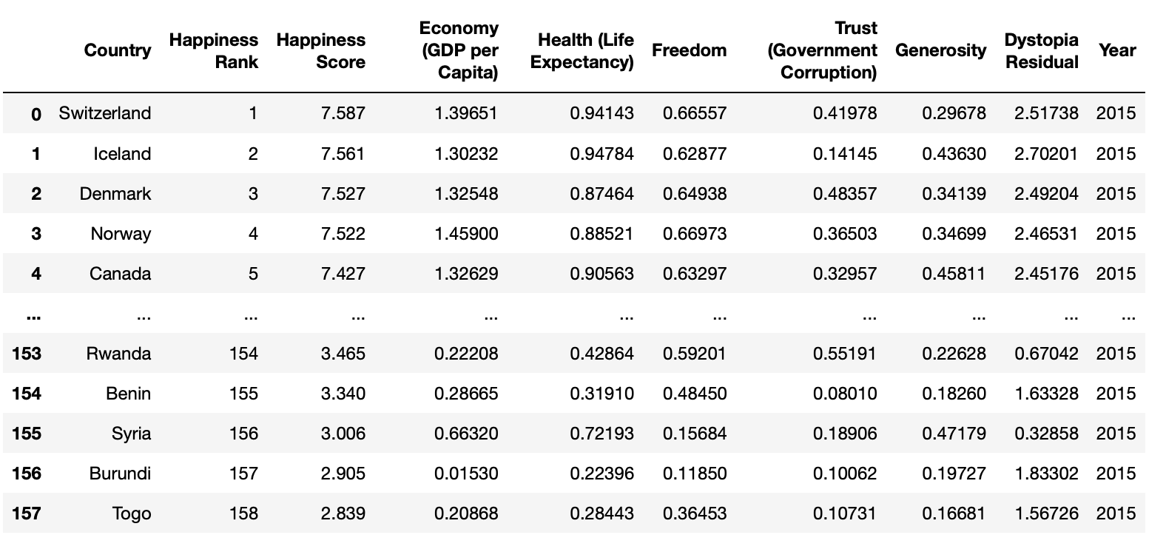

Slide 4
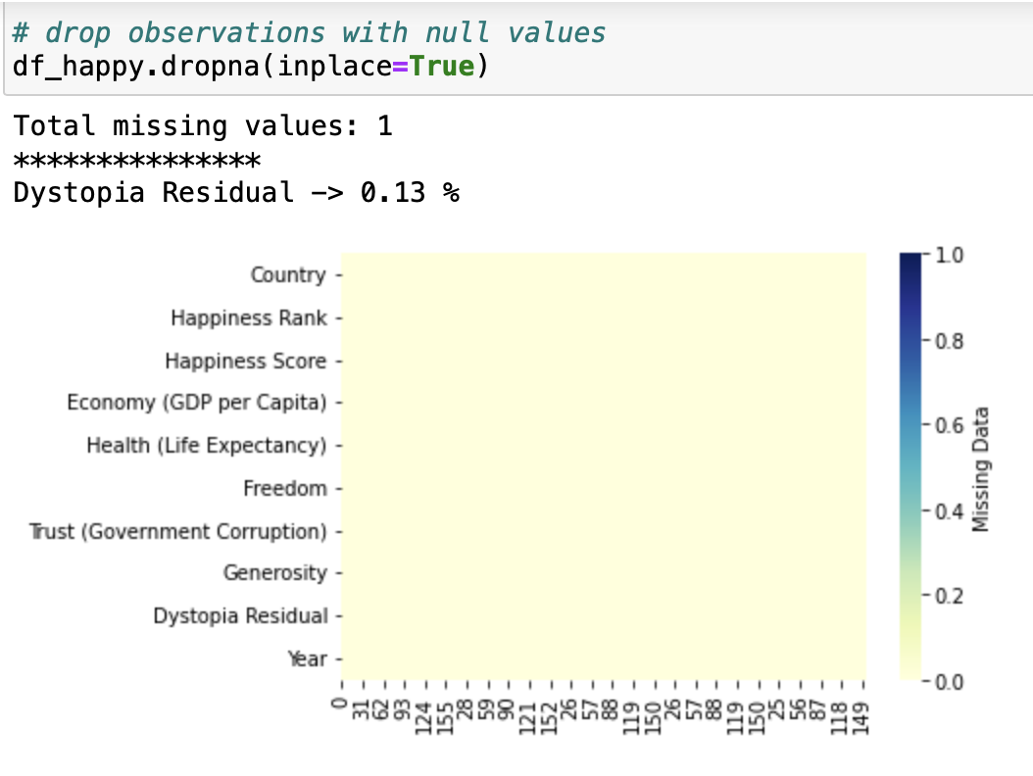
Data Profiling

Slide 5
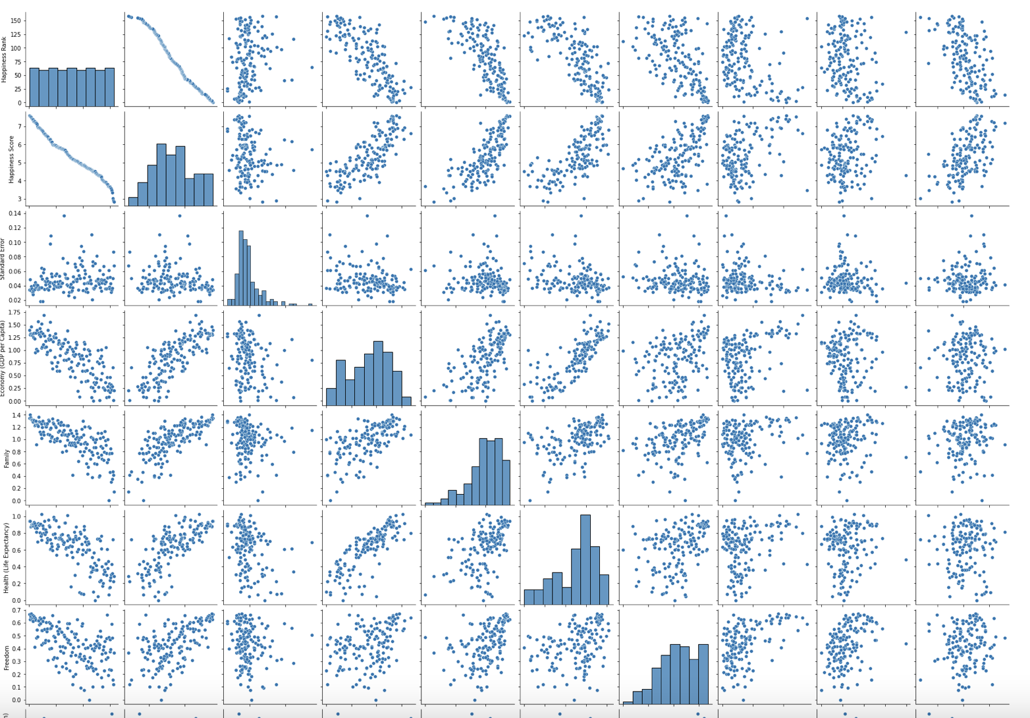
Correlation in data - Happiness index and score

Slide 6
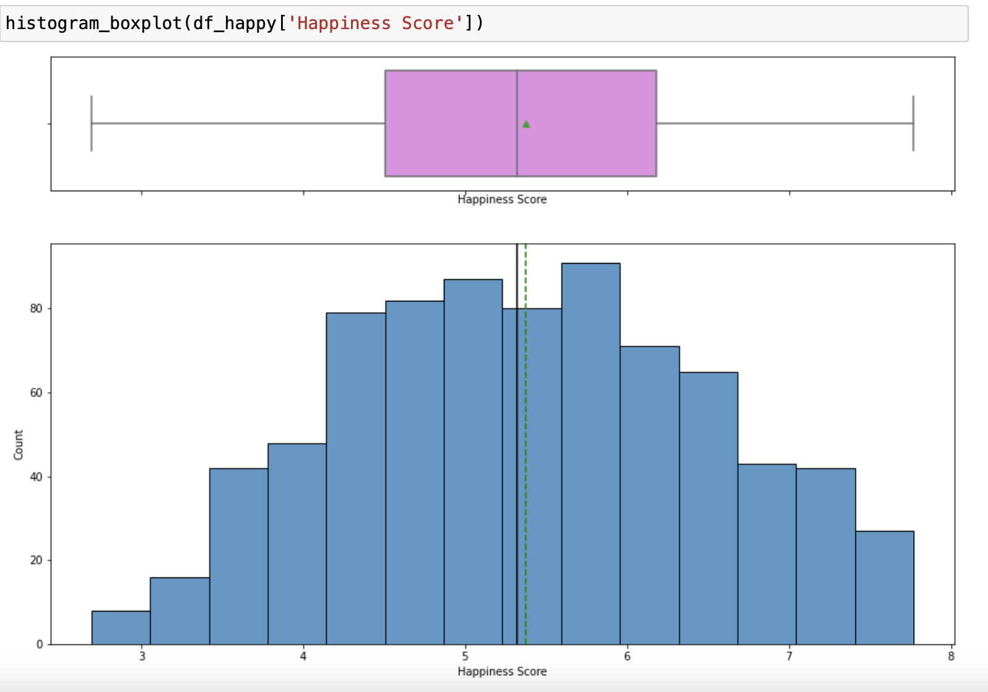
EDA - Exploratory Data Analysis

Slide 7
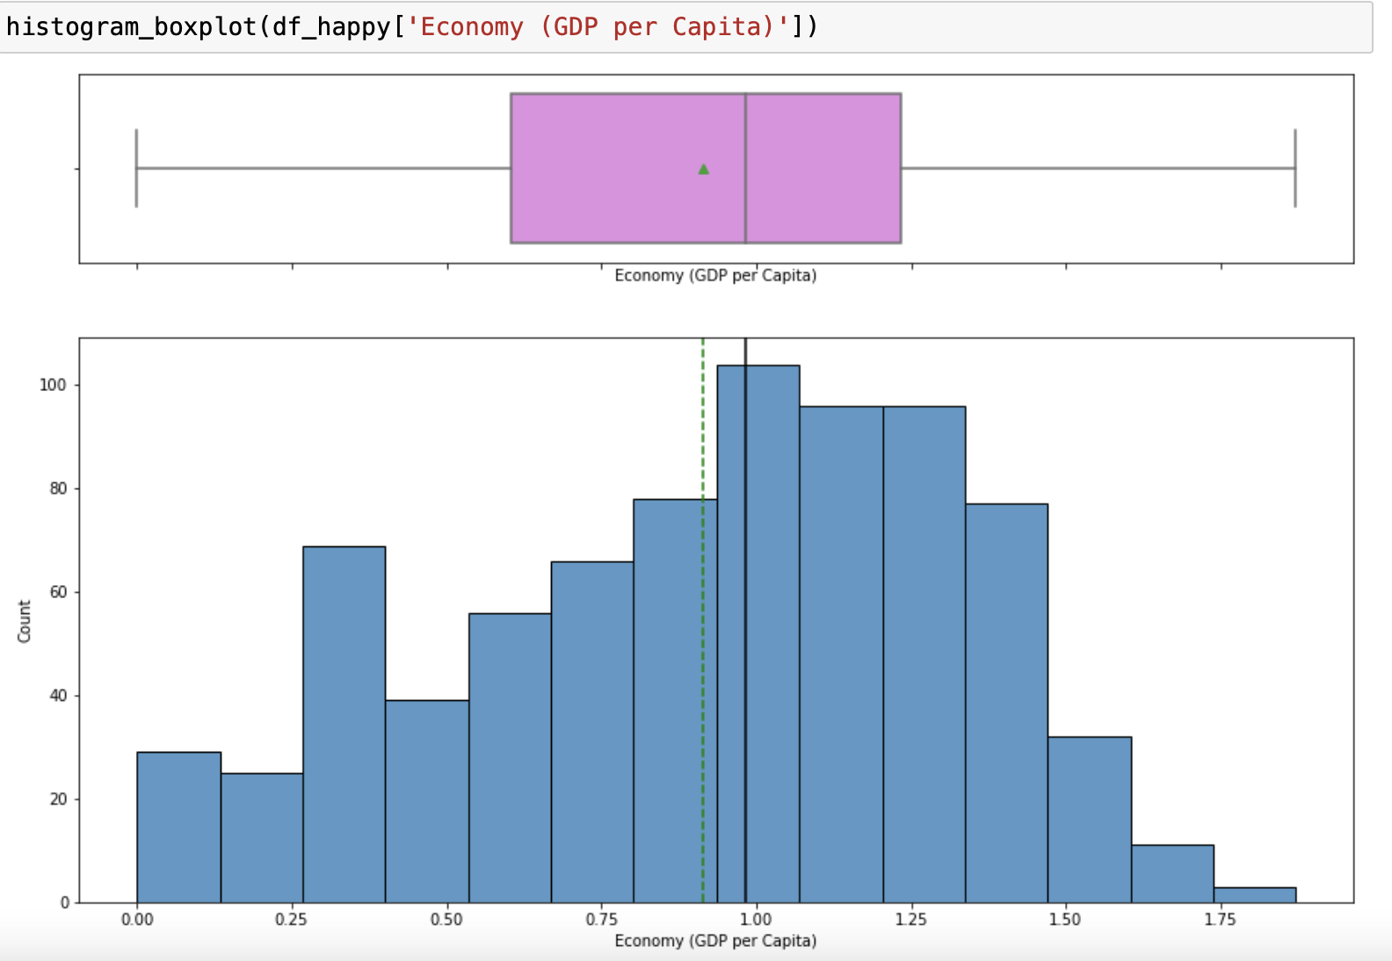

Slide 8
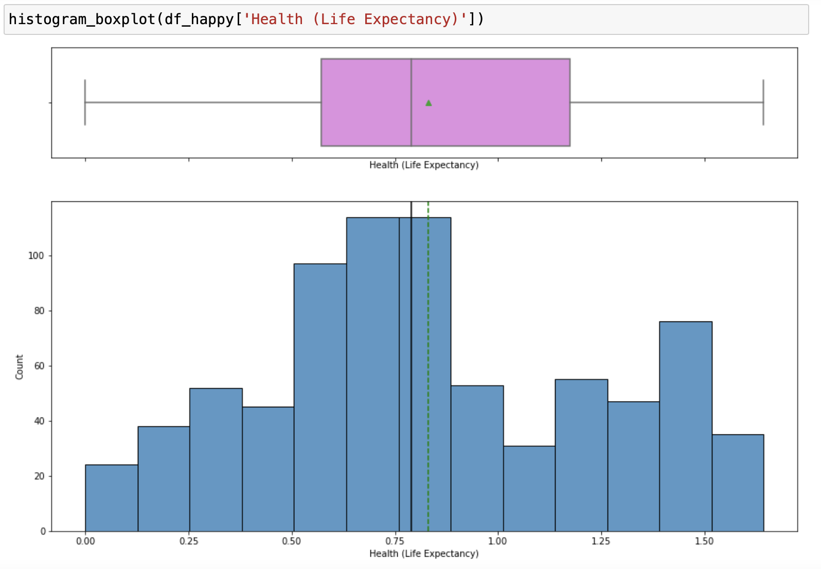

Slide 9
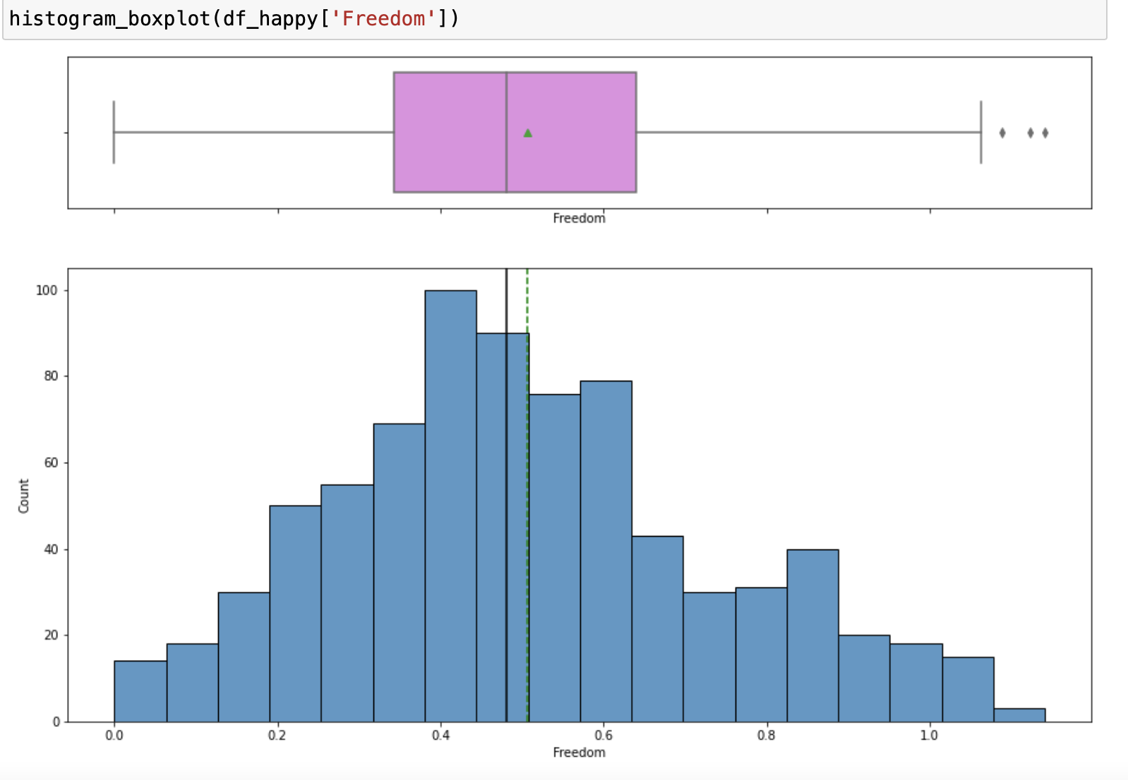

Slide 10
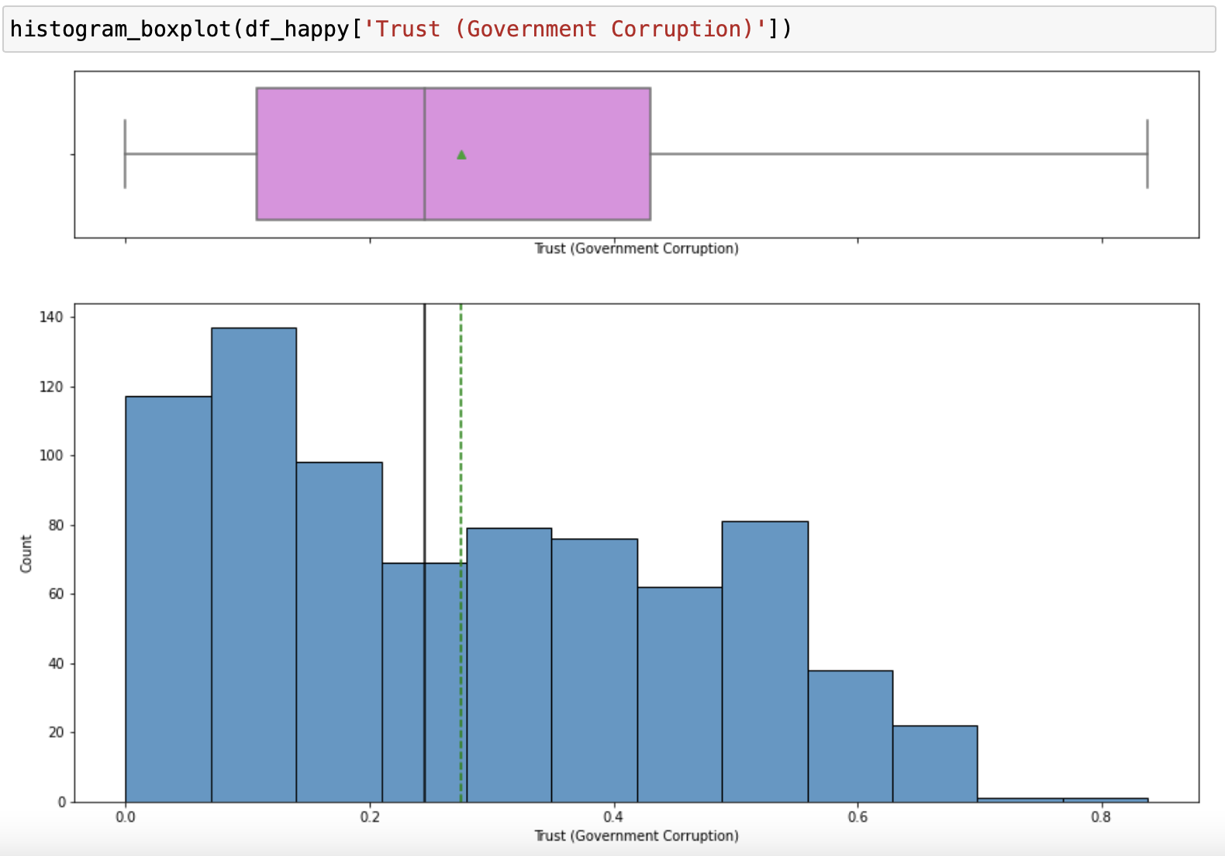

Slide 11
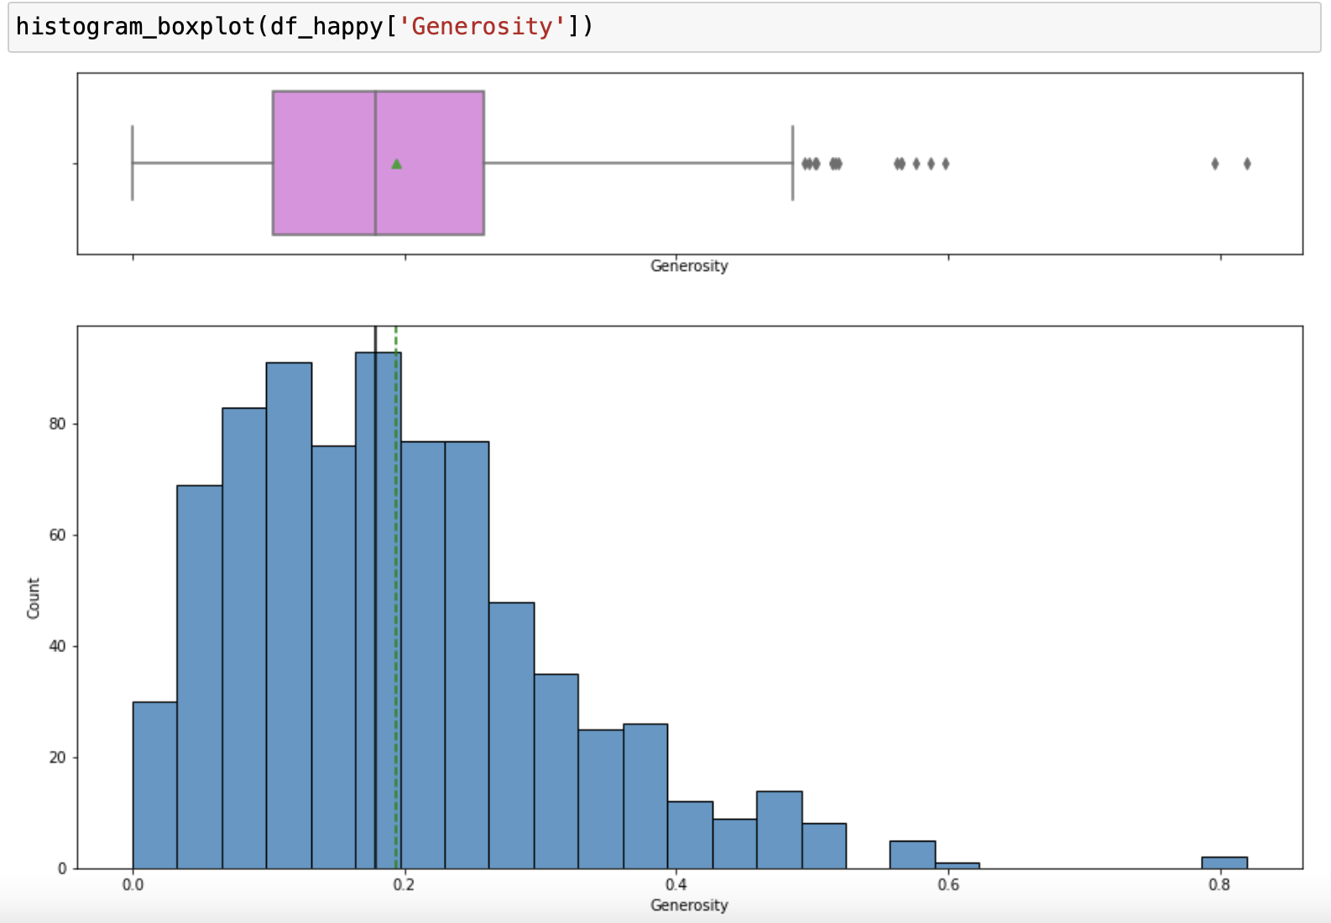

Slide 12
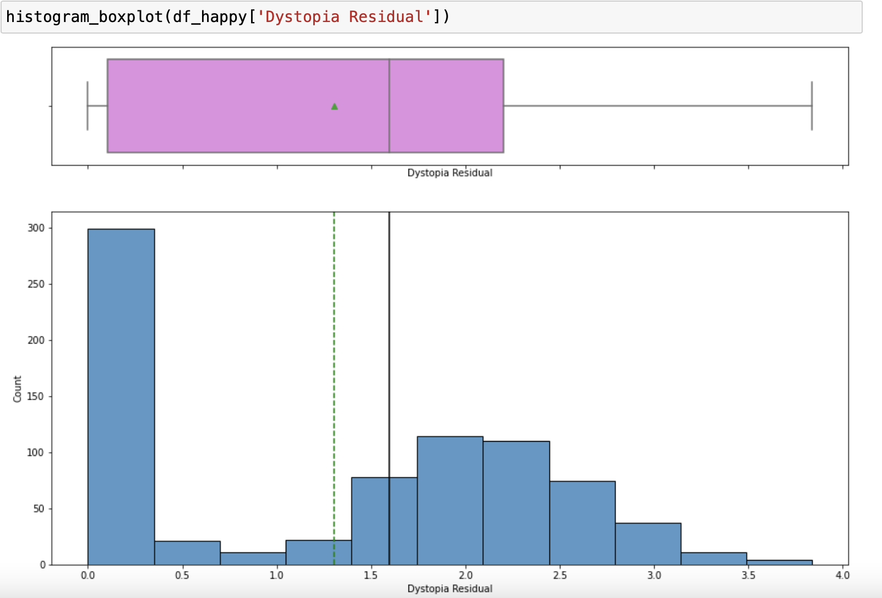

Slide 13
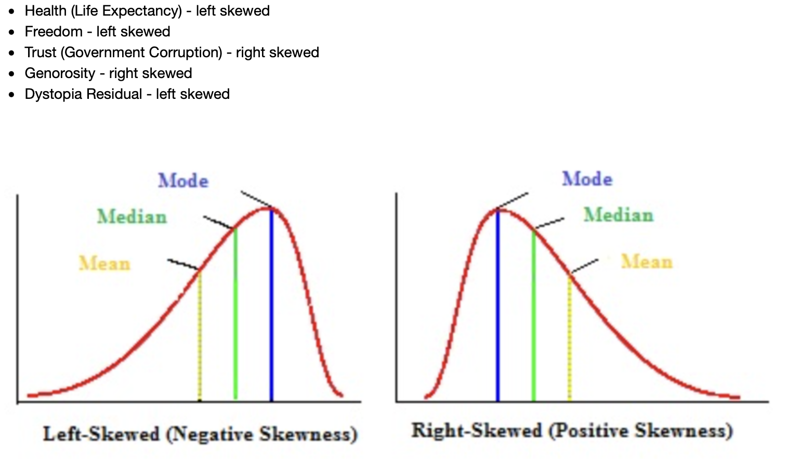

Slide 14
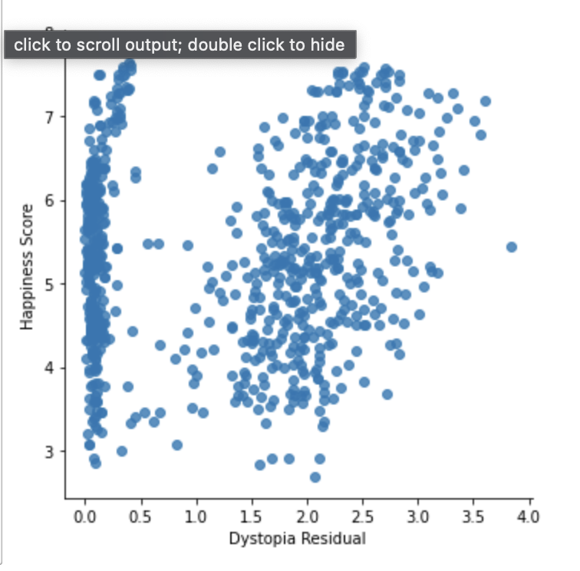

Slide 15
Train test Split - 80:20 & Preprocessing
–Column Transformers
–Numeric : StandardScaler(), PowerTransformer(method='yeo-johnson')
–Categorical : One Hot Encoder

Slide 16
Try multiple models

Slide 17
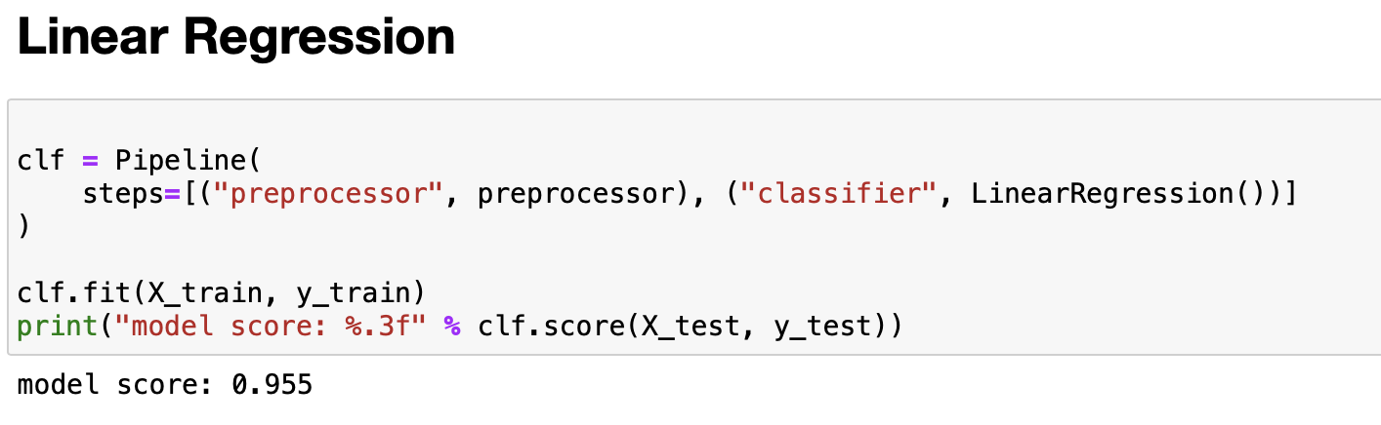

Slide 18
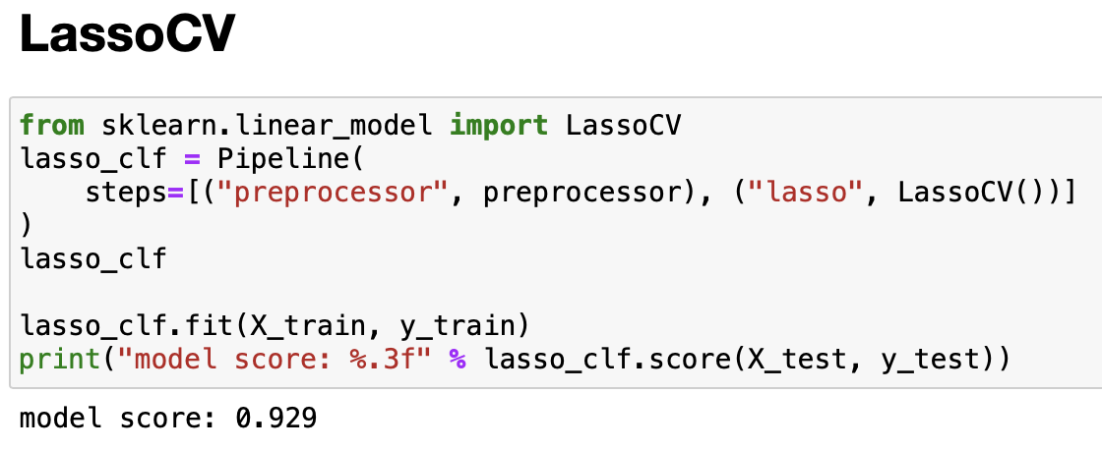

Slide 19
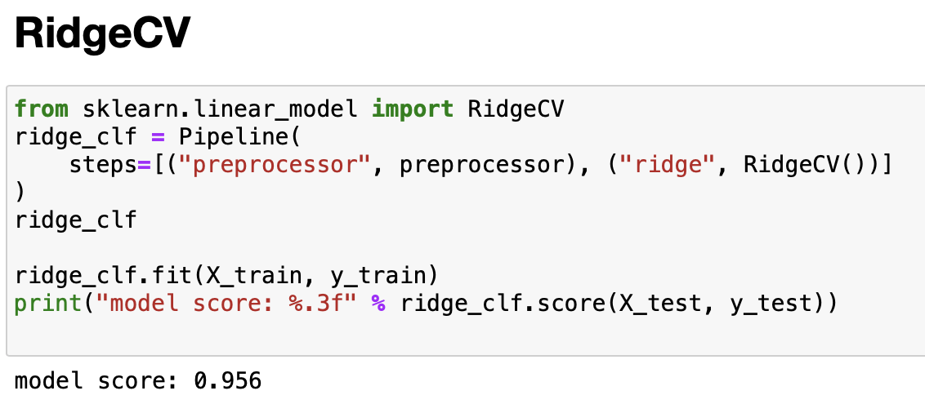

Slide 20
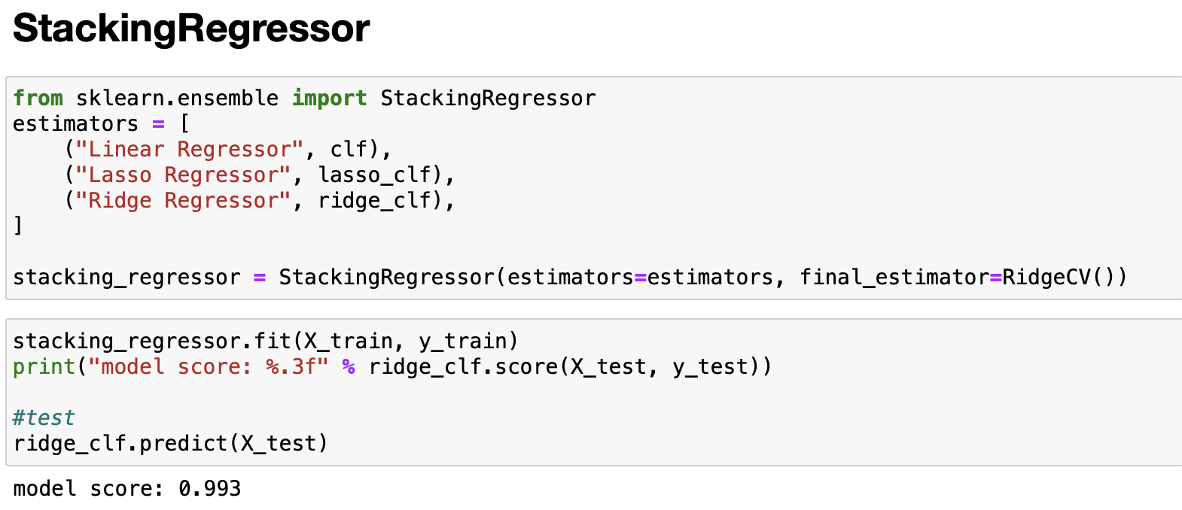

Slide 21
Hyperparameter tuning

Slide 22
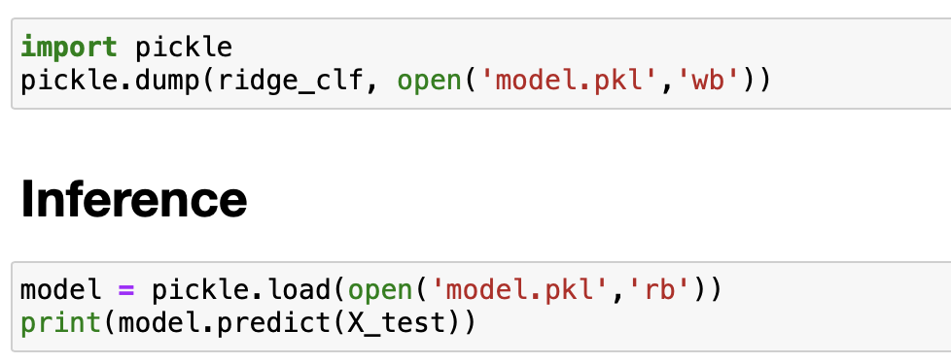

Slide 23
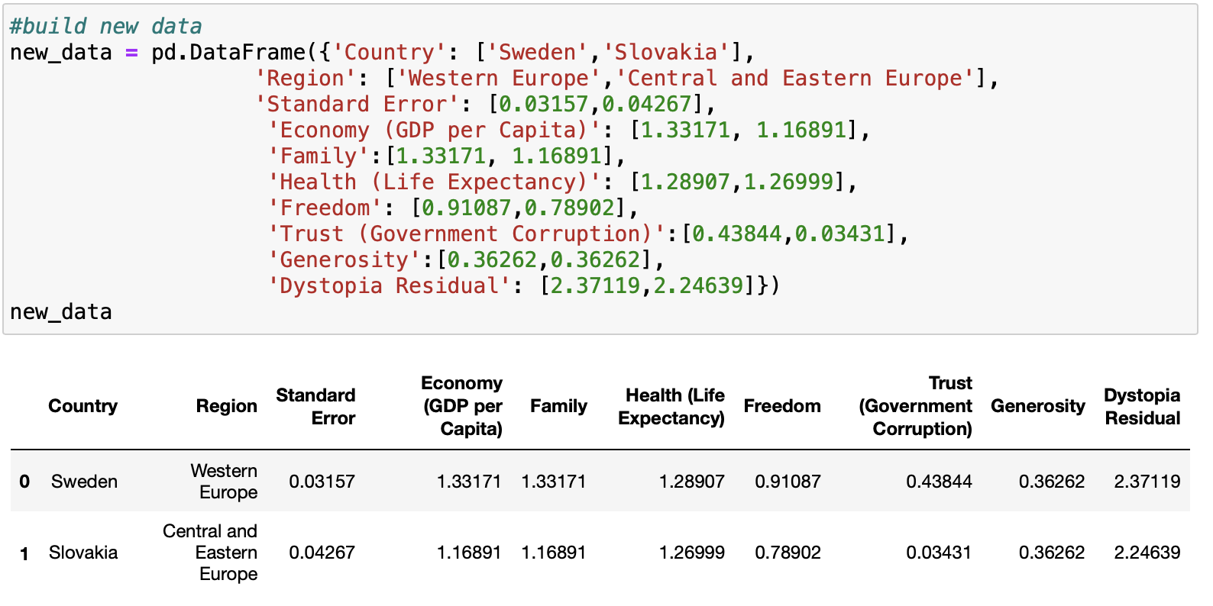
Testing on out of the box sample

Slide 24
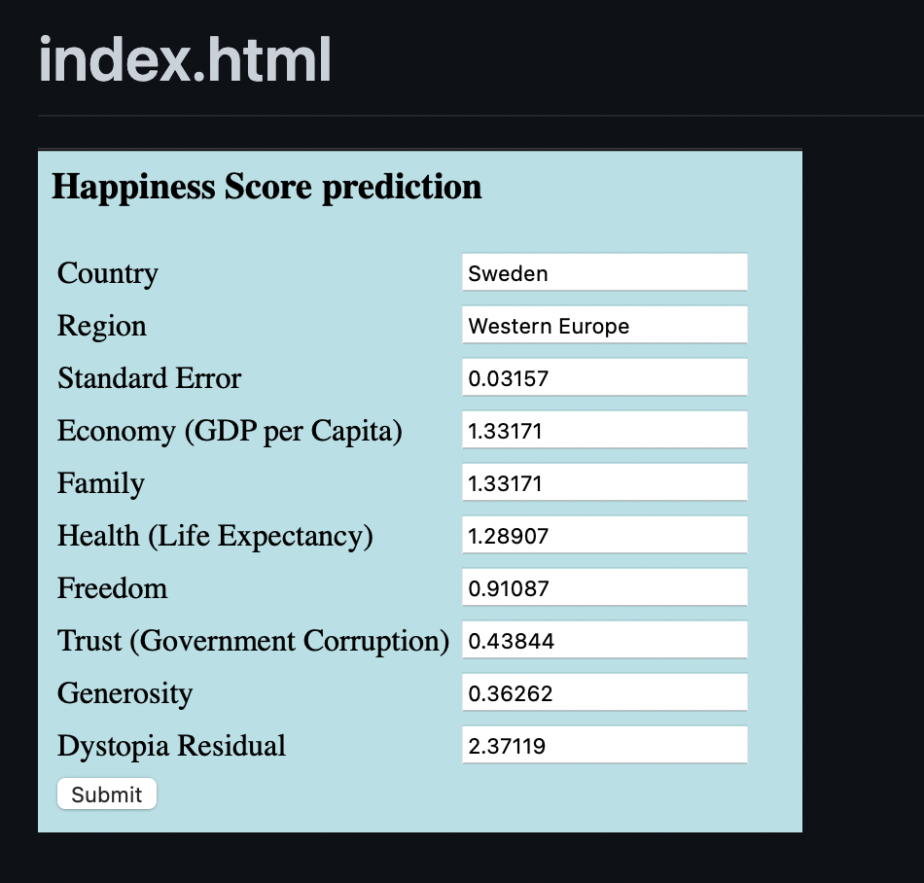
Deployment - Flask

Slide 25
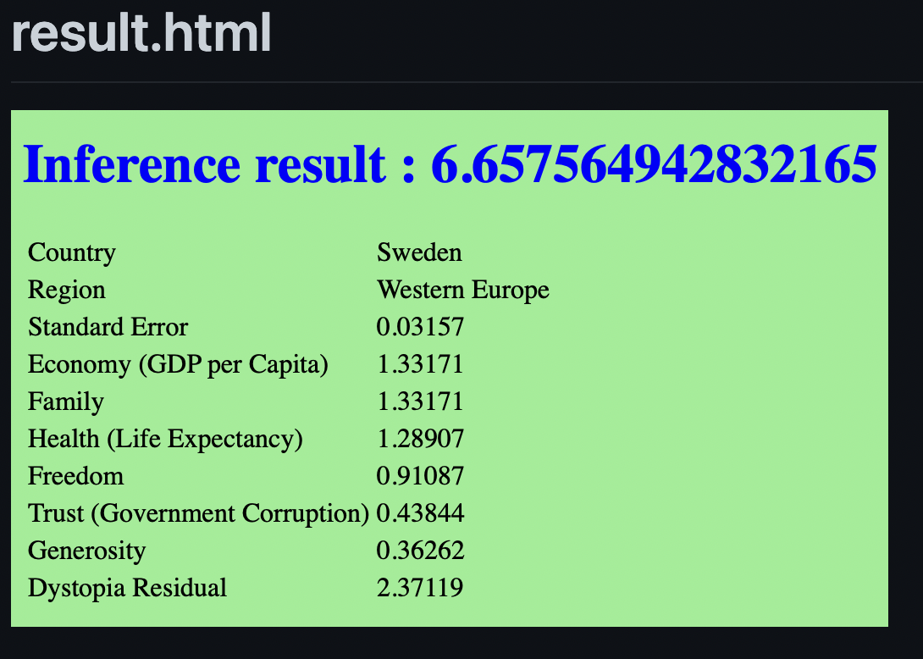

Slide 26
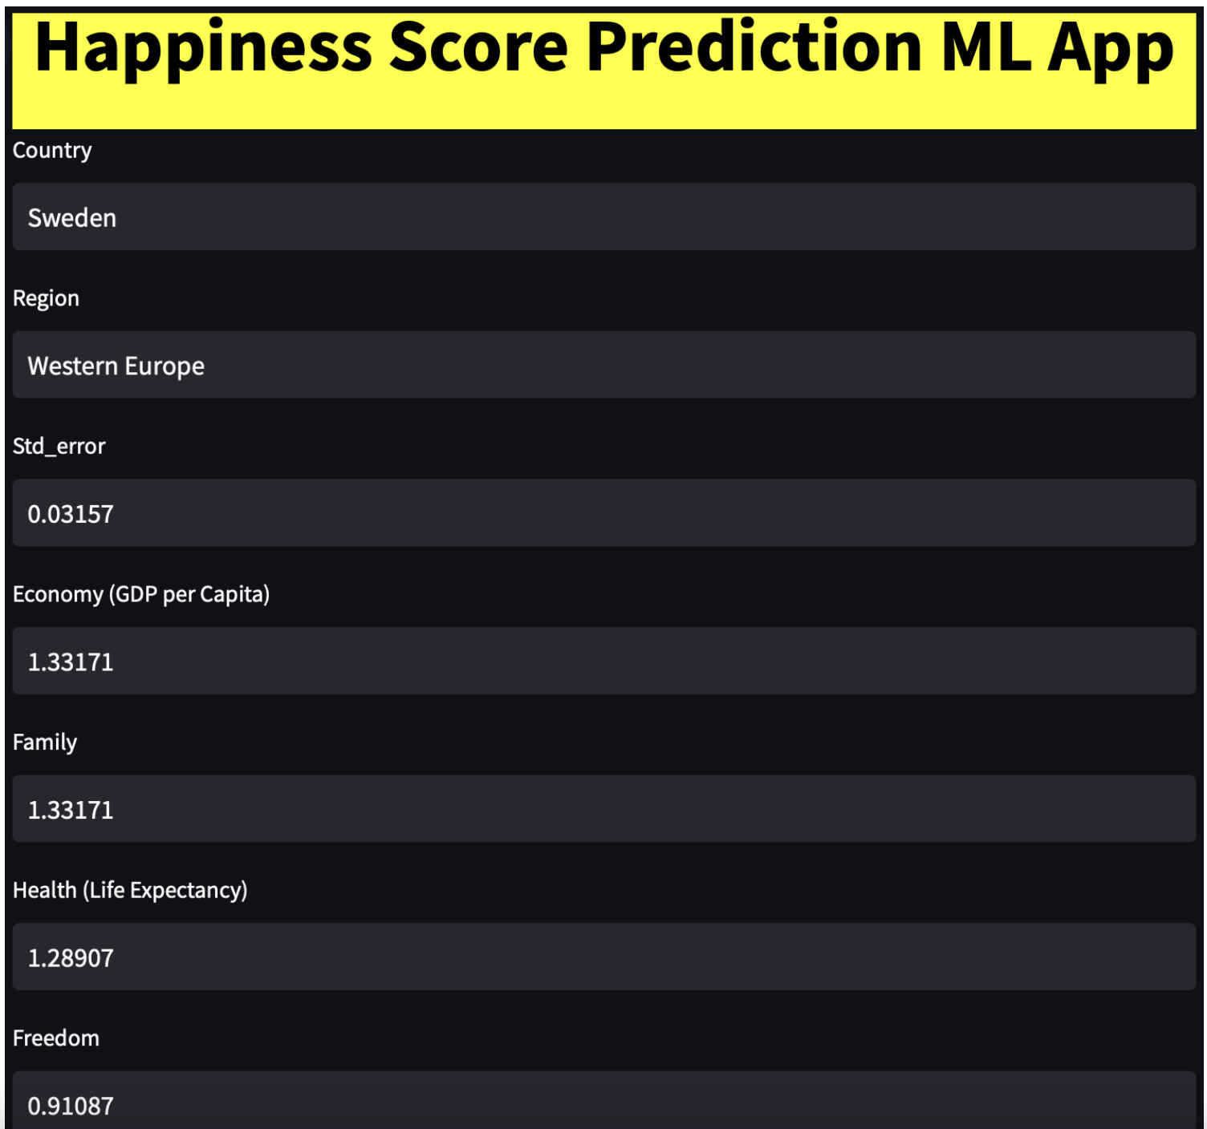
Deploy - streamlit

Slide 27
